Slide 1
Crowdfunding Your Business
Rowena Neville
Blue Line Consulting
@RowenaNeville

Slide 2
Crowdfunding involves an open call, Essentially through the internet, for the provision of financial resources Either in the form of a donation or in Exchange for some Form of reward…in order to support initiatives for specific purposes. An Empirical analysis of crowdfunding (2010) Lambert & Schweinbacher
Image : HipGive

Slide 3
Types of Crowdfunding
Image : Fundera

Slide 4
Crowdfunding : innovation or disruption?

Slide 5
Secret to successful crowdfunding?
Really strong creative idea +
Compelling message or story of Who, What, When, Where and WHY +
Network of interested and engaged people, with the means to give +
Great must-have rewards +
Transparent budget +
Time to run the campaign +
Hard work and great ideas to get the message out
= Success!

Slide 6
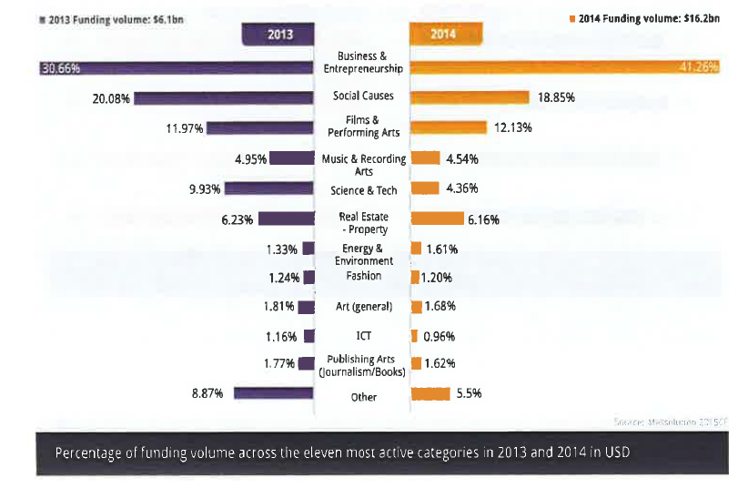
Most Active Categories – All Platforms
Source: 2015CF The Crowdfunding Industry Report (2015) masssolution.com

Slide 7
Active Categories – All Platforms
Source: 2013 Crowdfunding Industry Report (2014) masssolution.com
Across all crowdfunding sites the median successful project value is less than $5,000

Slide 8
Brookwood pottery case study: Fundit.ie
Raised €16,770 from 279 funders – most successful design category project on Fund it
https://fundit.ie/info/design-case-study-brookwood-pottery/

Slide 9
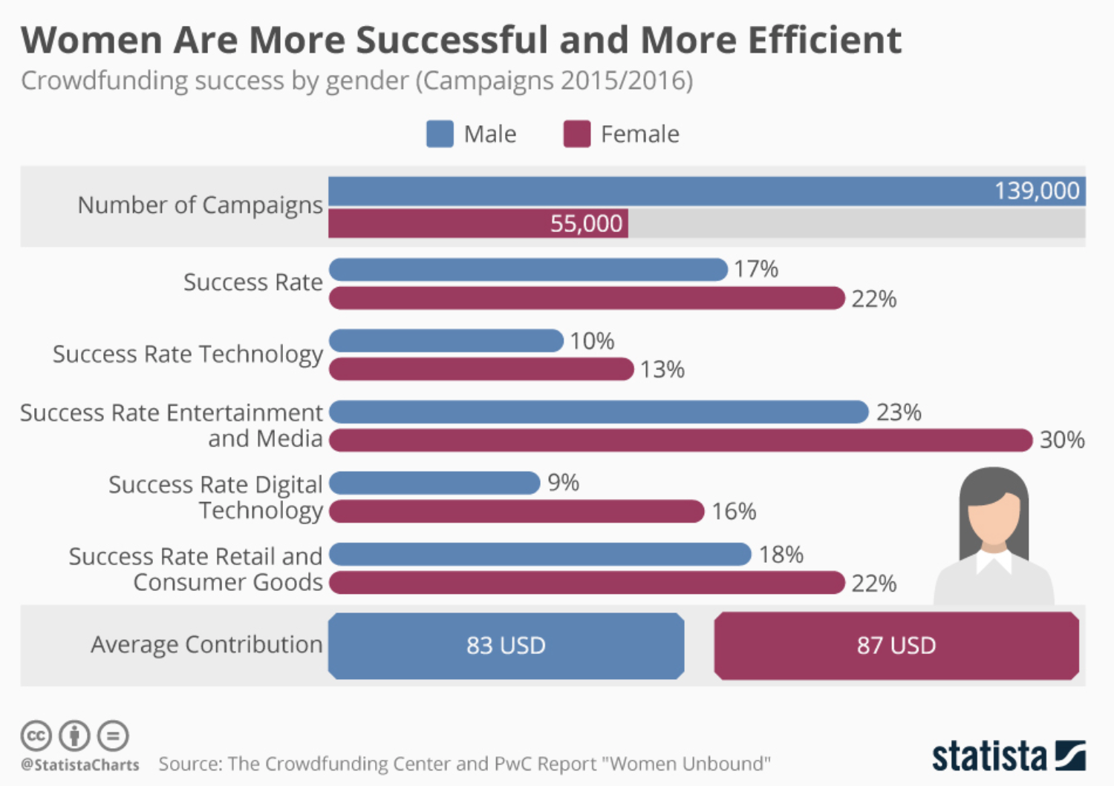

Slide 10
PROS
CONS
New fundraising opportunity Marketing & pre-sales Consumer/Audience engagement Value in social network Legalities/Governance/Reputation Budgeting/planning Fundraising experience | Appropriate fundraising platform? Fees/charges/decline rates All-or-nothing approach Consumer/Audience engagement Time/labour intensive Computer & social media skills Regulation/IP/Tax/Finance
Notes:
“Non-profit organisations show up strongly as the primary driver of success [with crowdfunding] while other variables are never significant.” Lambert, T & Schwienbacher A (2010)

Slide 11
Mass Emails
Personal & Organisational
Launch (Informative)
Throughout (Targeted)
Midway (General Update)
Prior to End (General Update)
Communicating while running your campaign
Social Media
Event Pages
Project Videos/Photos/ Media
Personalised Thank You
Competitions
Activity updates
Other Media
Targeted
Informative
National & International
Don’t forget local media!

Slide 12
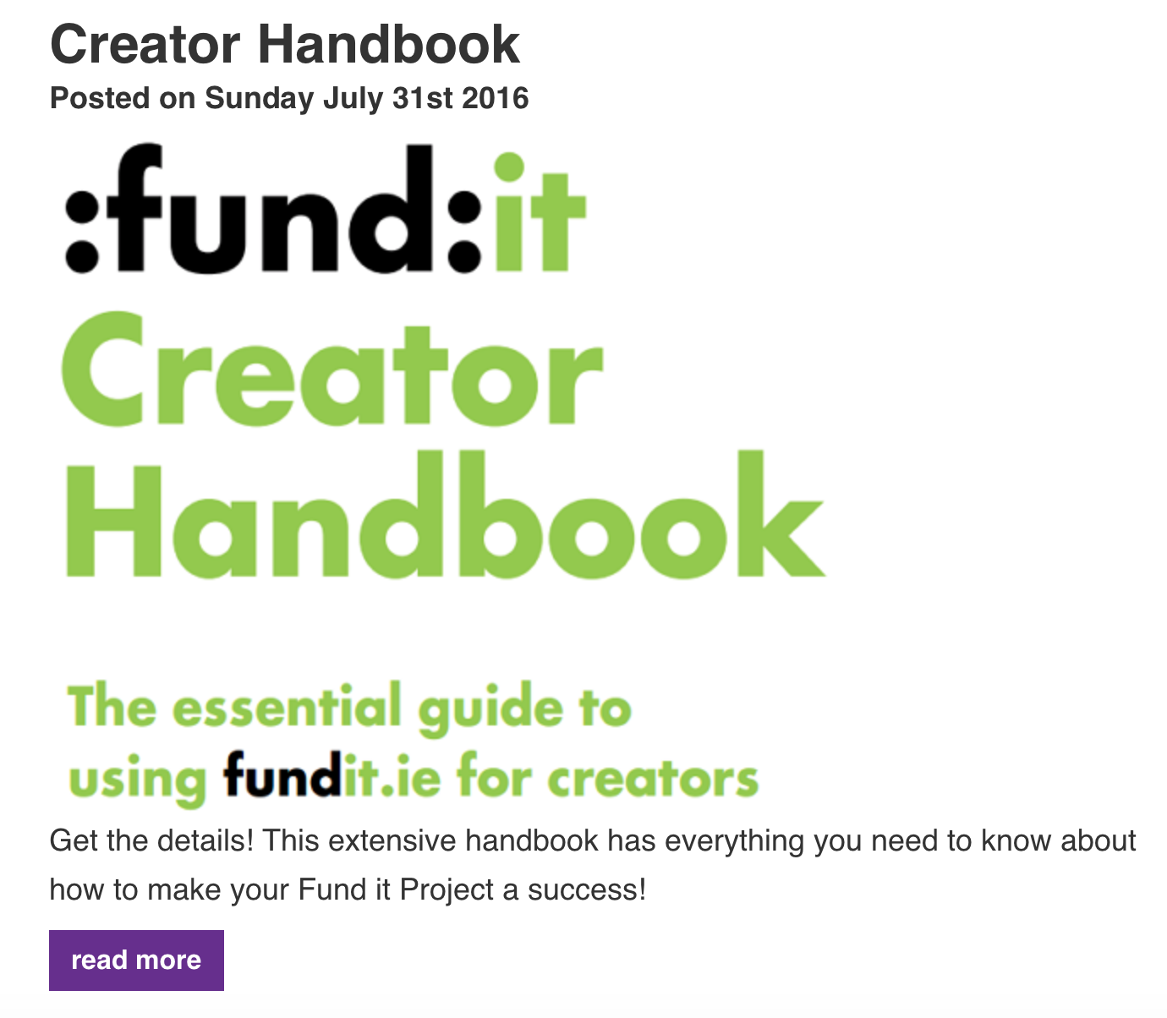
Resources Available to Help you Plan

Slide 13
@RowenaNeville
Best of luck!

